Slide 1
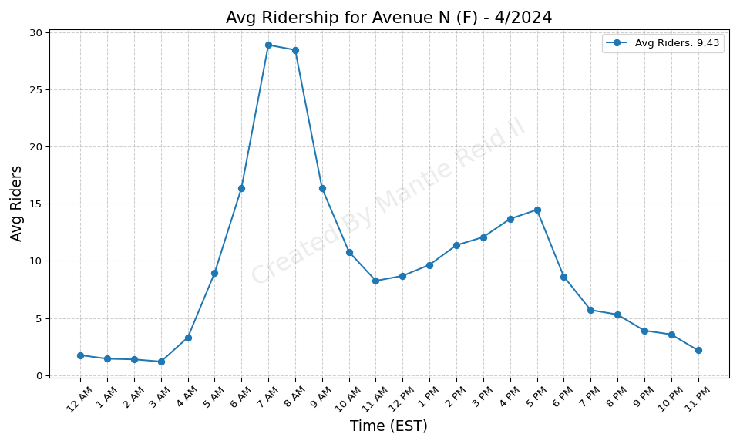
Avenue N (F) - 4/2024

Slide 2
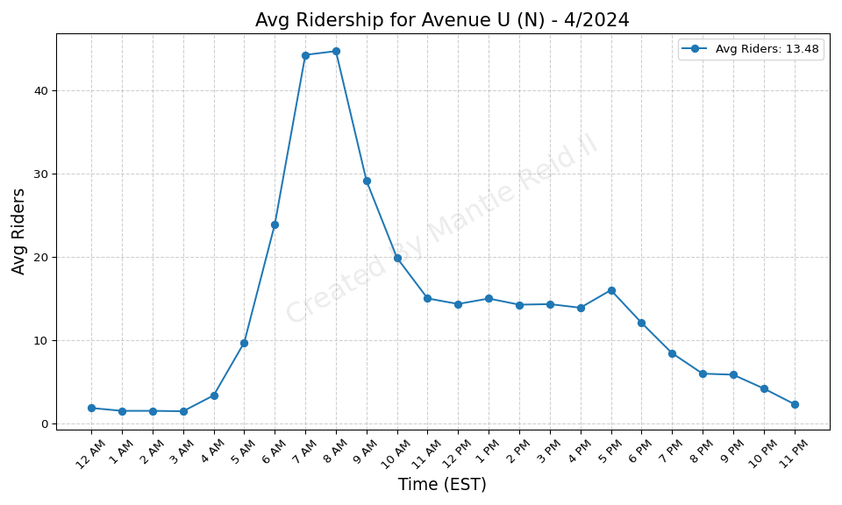
Avenue U (N) - 4/2024

Slide 3
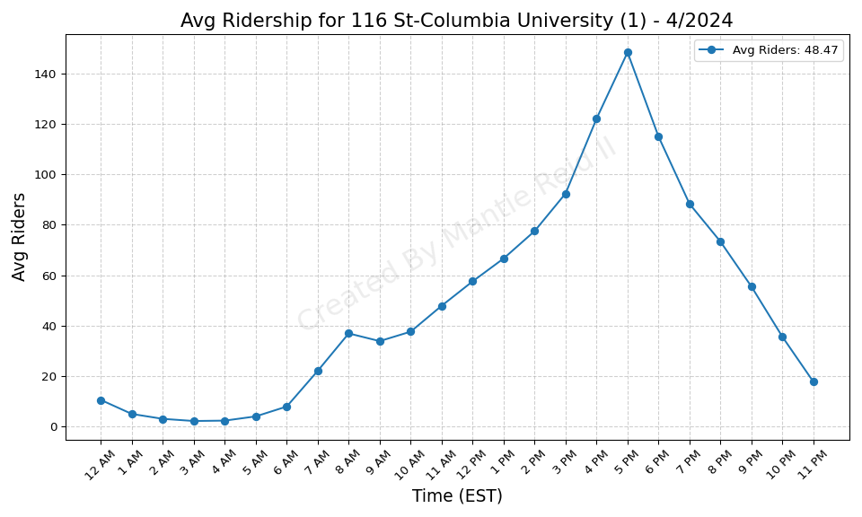
116 St-Columbia University (1) - 4/2024

Slide 4
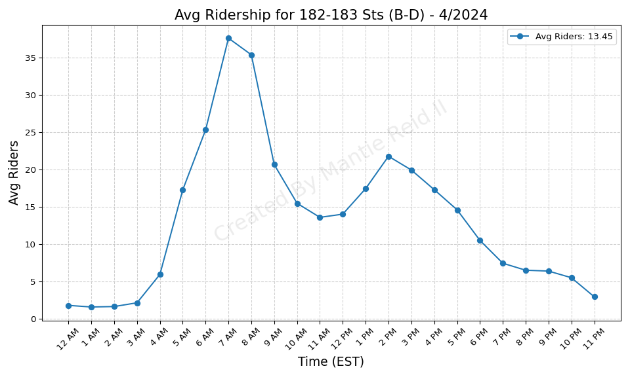
182-183 Sts (B-D) - 4/2024

Slide 5
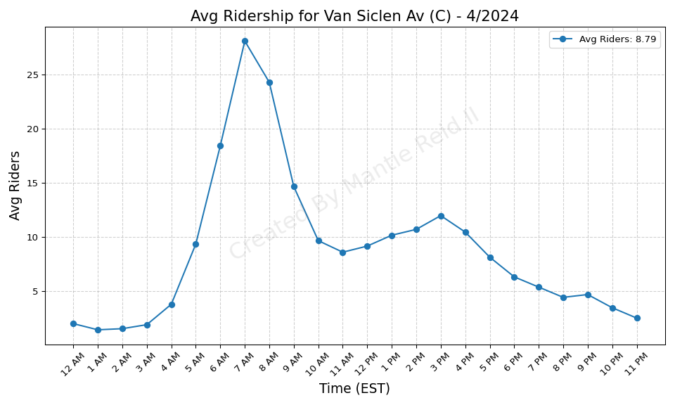
Van Siclen Av (C) - 4/2024

Slide 6
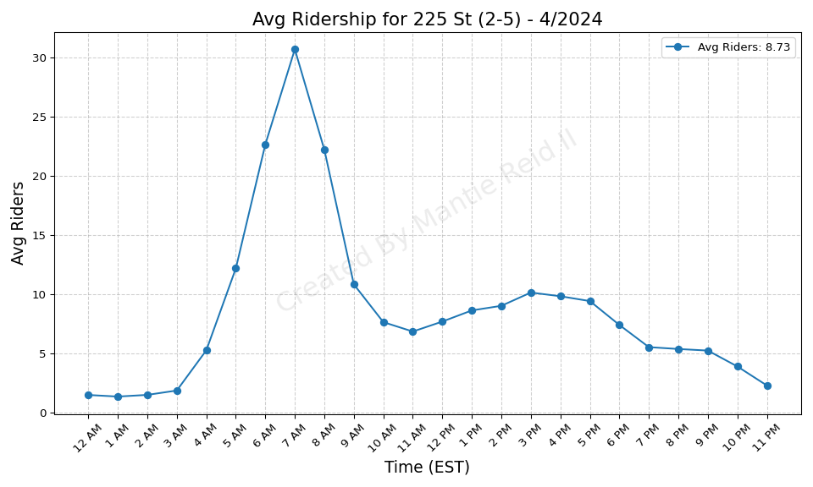
225 St (2-5) - 4/2024

Slide 7
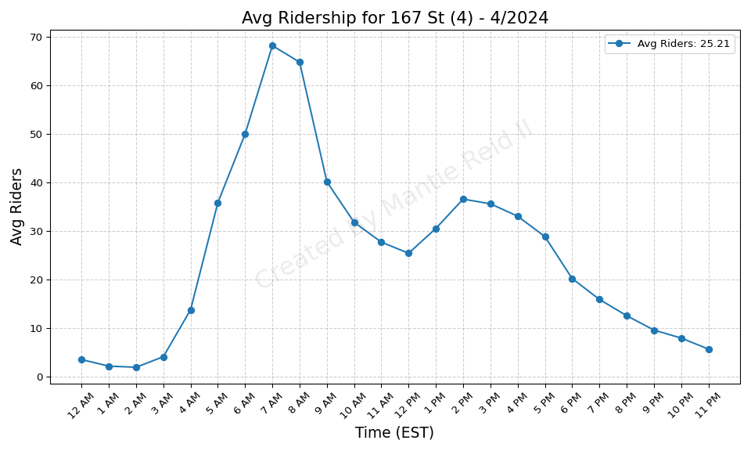
167 St (4) - 4/2024

Slide 8
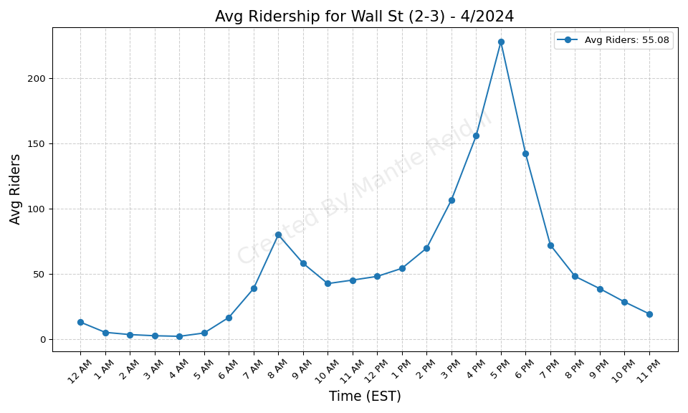
Wall St (2-3) - 4/2024

Slide 9
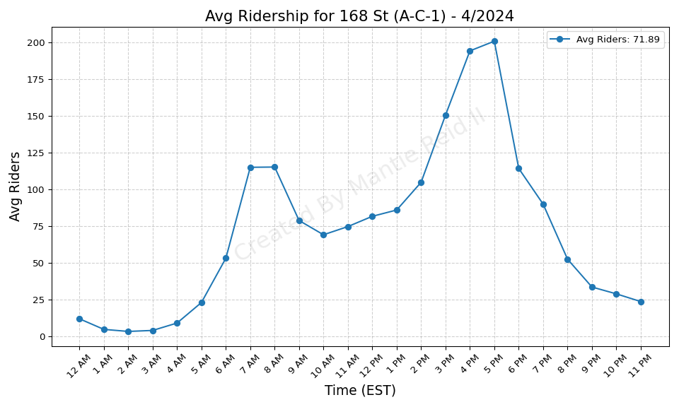
168 St (A-C-1) - 4/2024

Slide 10
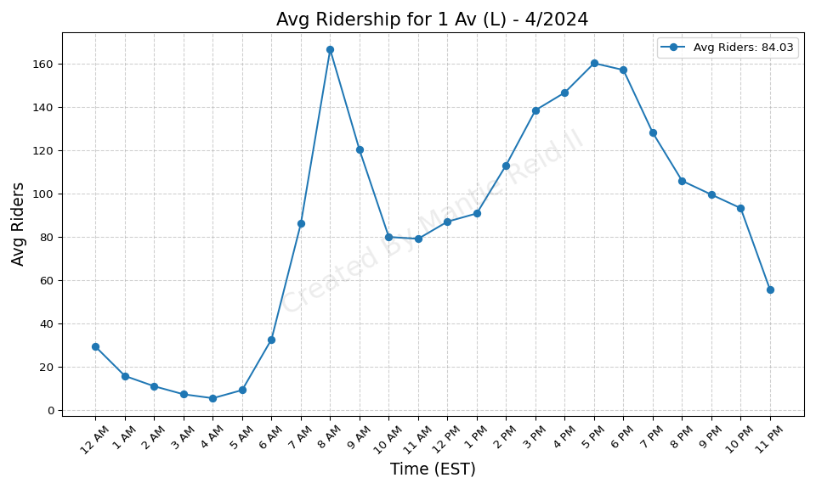
1 Av (L) - 4/2024

Slide 11
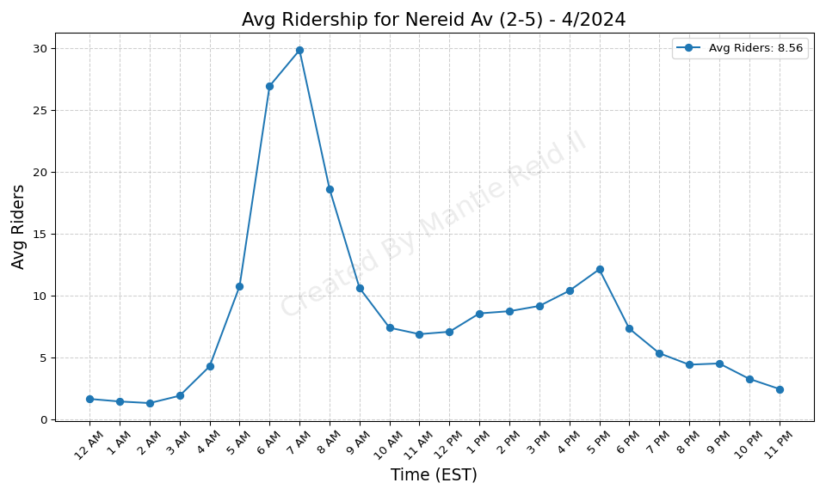
Nereid Av (2-5) - 4/2024

Slide 12
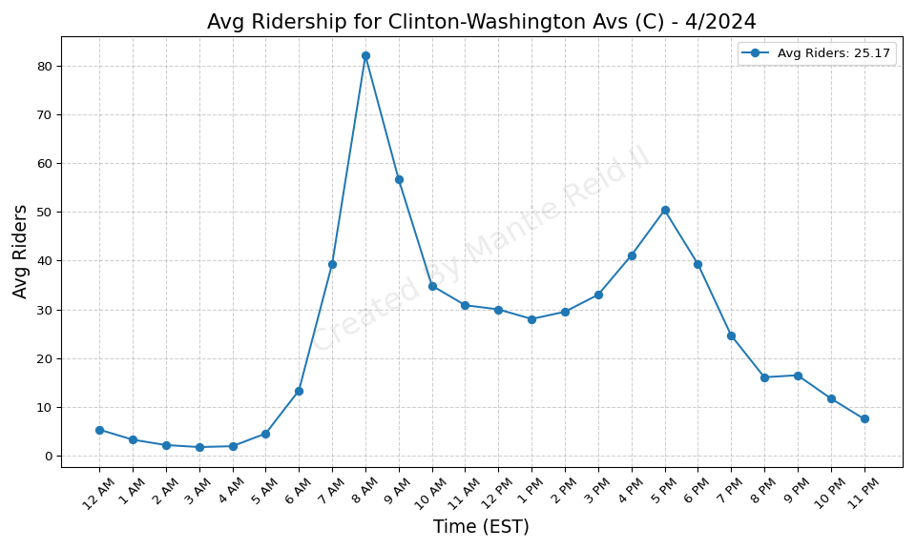
Clinton-Washington Avs (C) - 4/2024

Slide 13
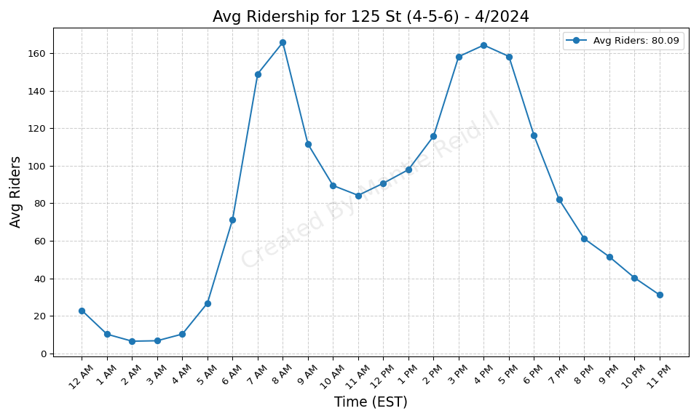
125 St (4-5-6) - 4/2024

Slide 14
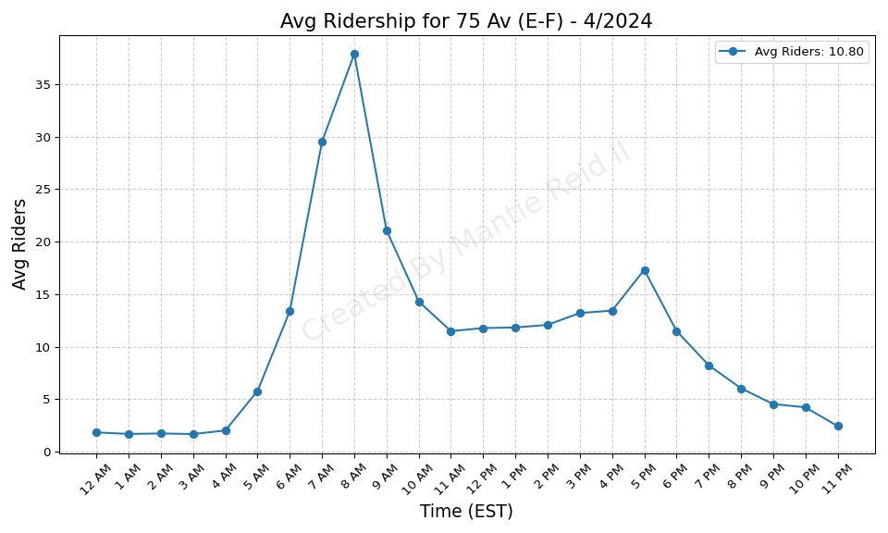
75 Av (E-F) - 4/2024

Slide 15
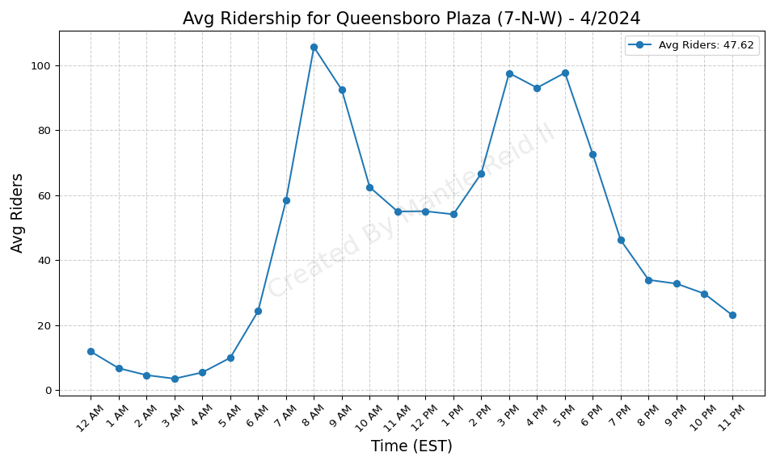
Queensboro Plaza (7-N-W) - 4/2024

Slide 16

Zerega Av (6) - 4/2024

Slide 17
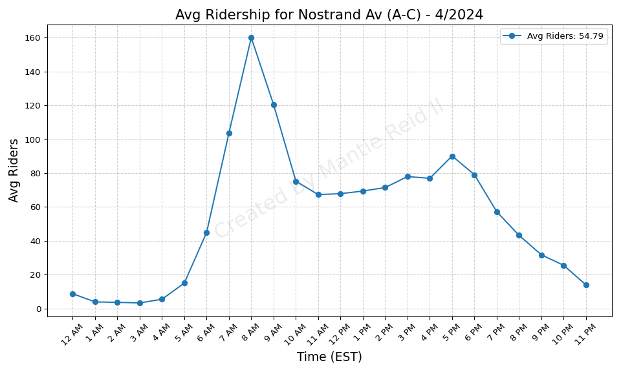
Nostrand Av (A-C) - 4/2024

Slide 18
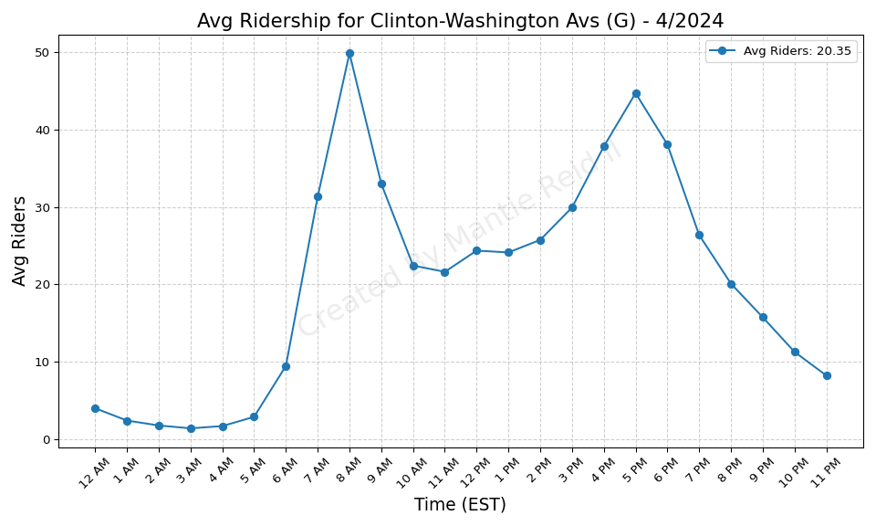
Clinton-Washington Avs (G) - 4/2024

Slide 19
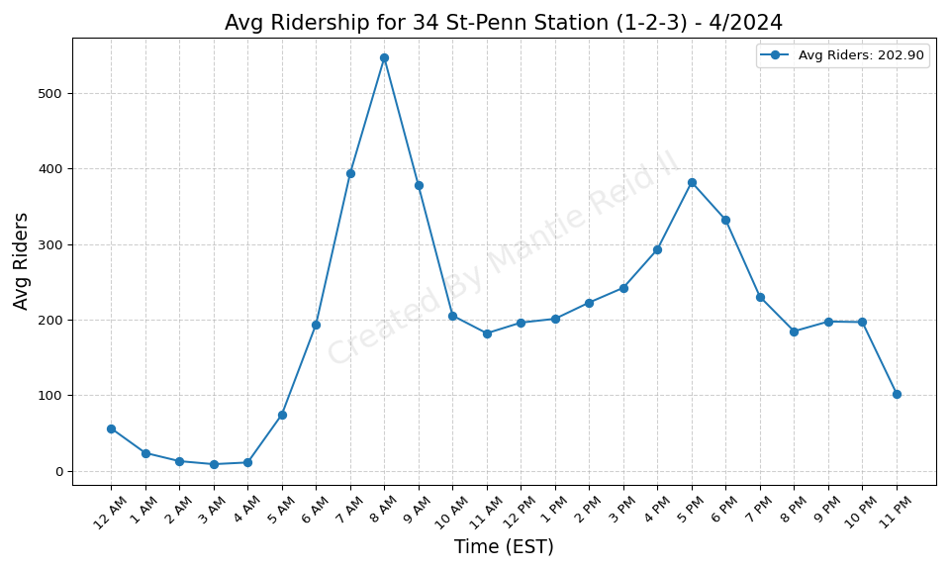
34 St-Penn Station (1-2-3) - 4/2024

Slide 20
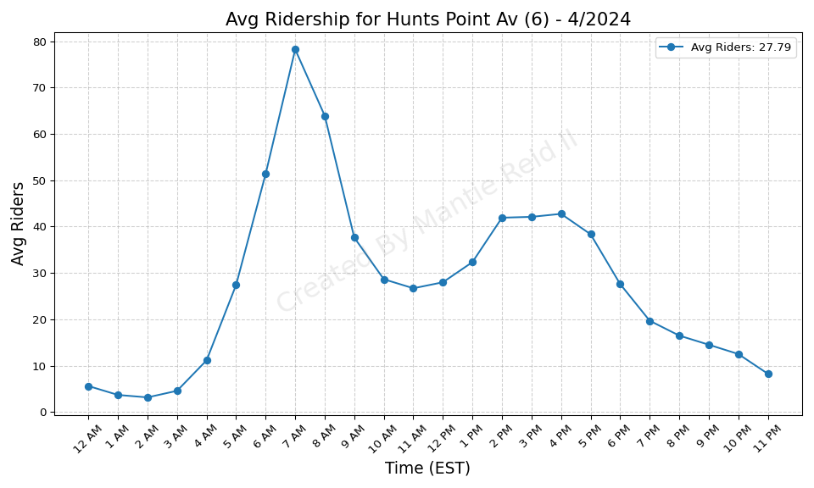
Hunts Point Av (6) - 4/2024

Slide 21
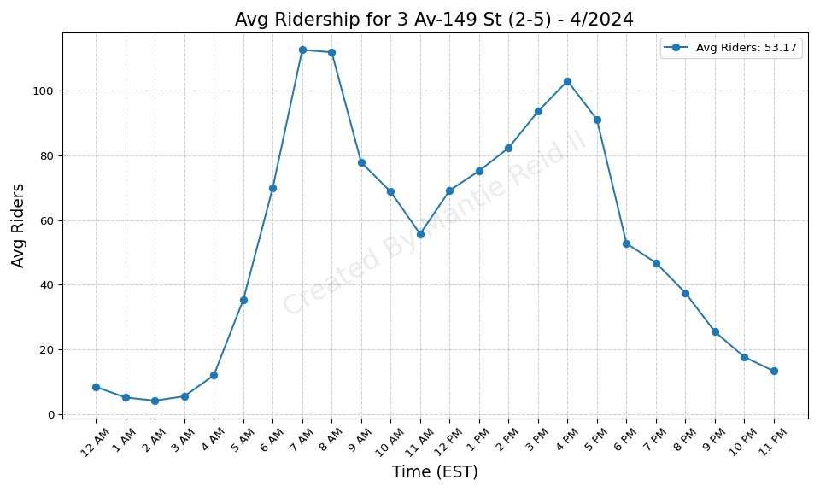
3 Av-149 St (2-5) - 4/2024

Slide 22
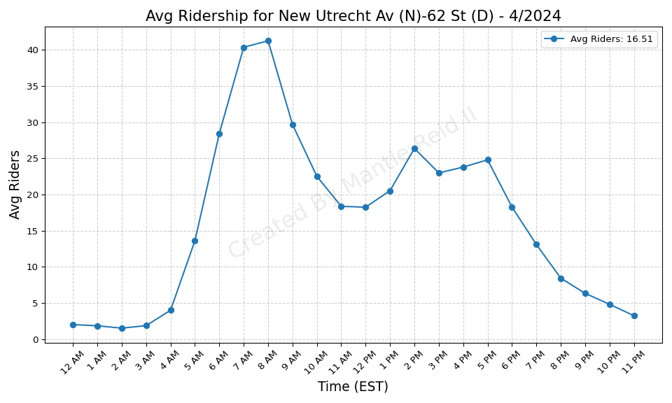
New Utrecht Av (N)-62 St (D) - 4/2024

Slide 23
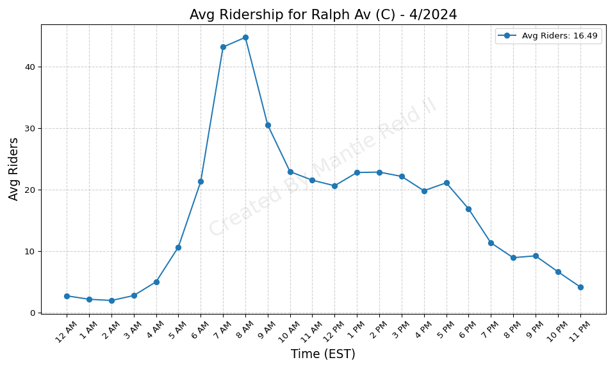
Ralph Av (C) - 4/2024

Slide 24
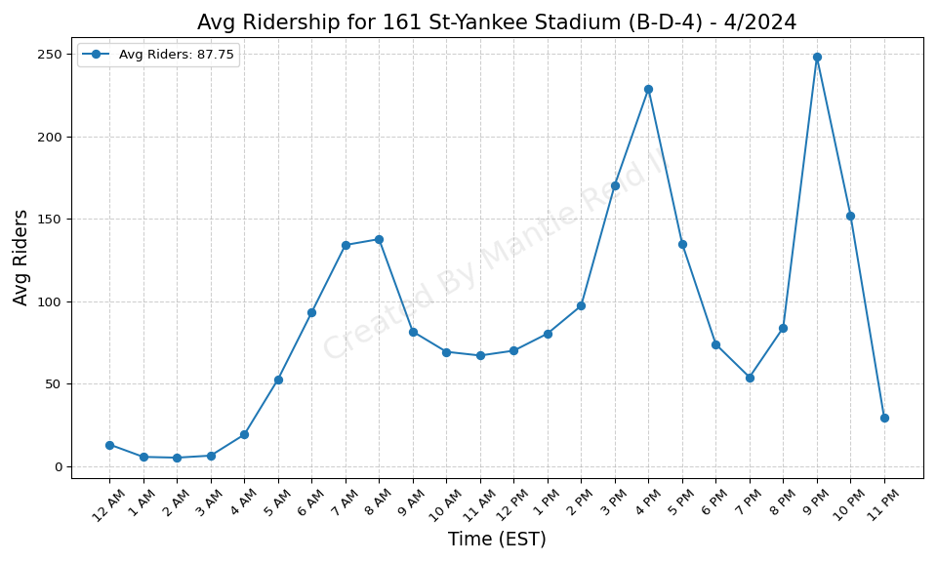
161 St-Yankee Stadium (B-D-4) - 4/2024

Slide 25
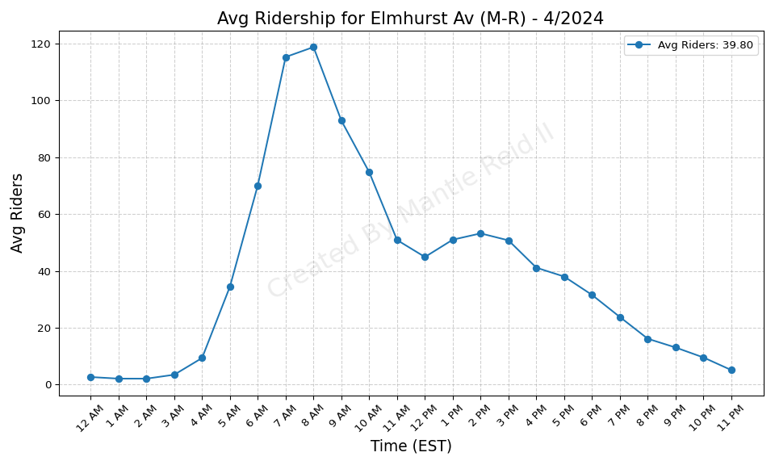
Elmhurst Av (M-R) - 4/2024

Slide 26
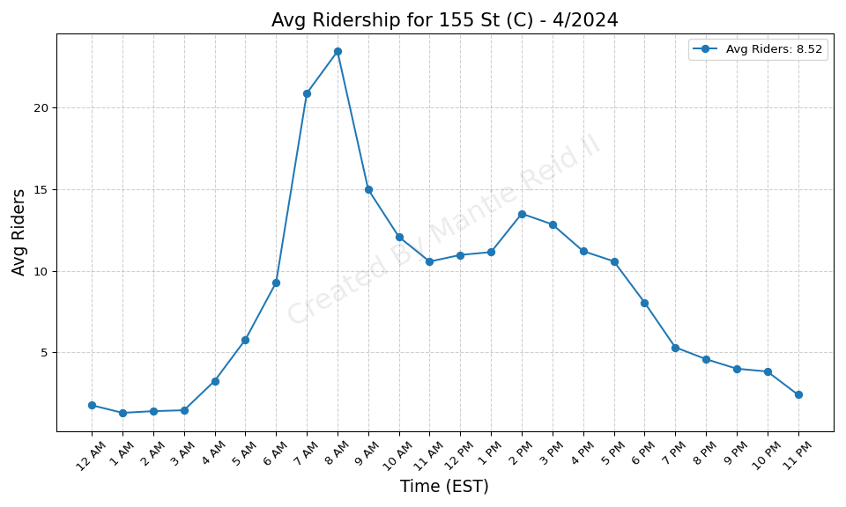
155 St (C) - 4/2024

Slide 27
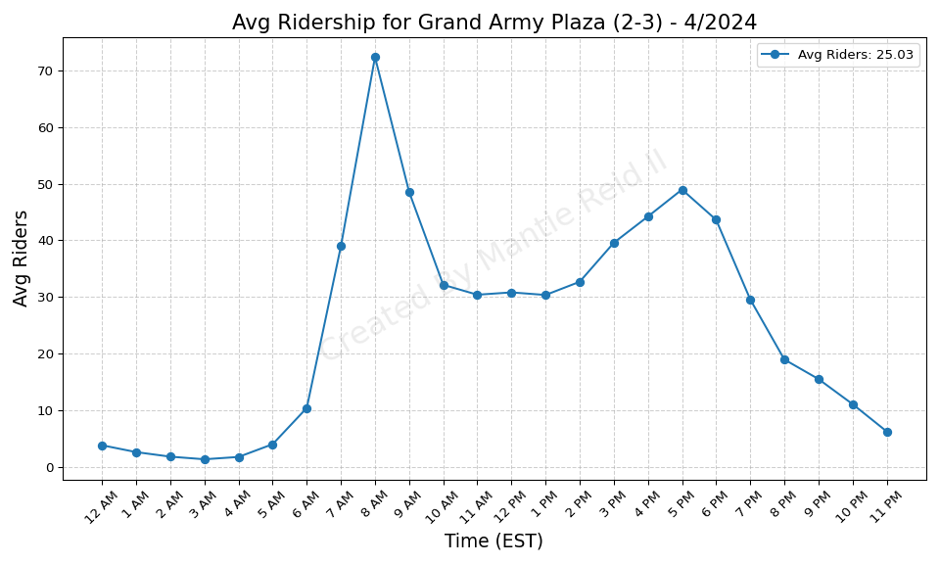
Grand Army Plaza (2-3) - 4/2024

Slide 28

Euclid Av (A-C) - 4/2024

Slide 29
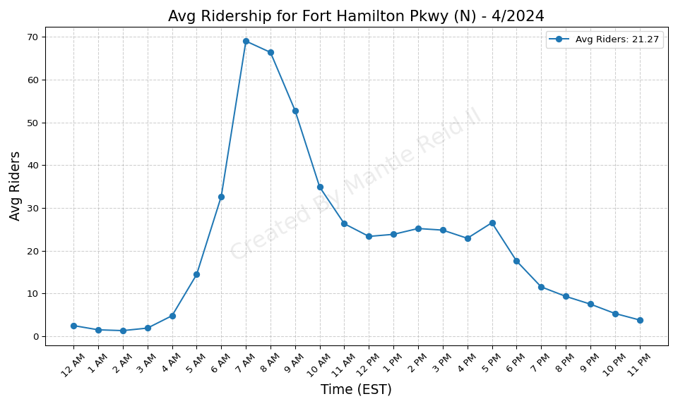
Fort Hamilton Pkwy (N) - 4/2024

Slide 30
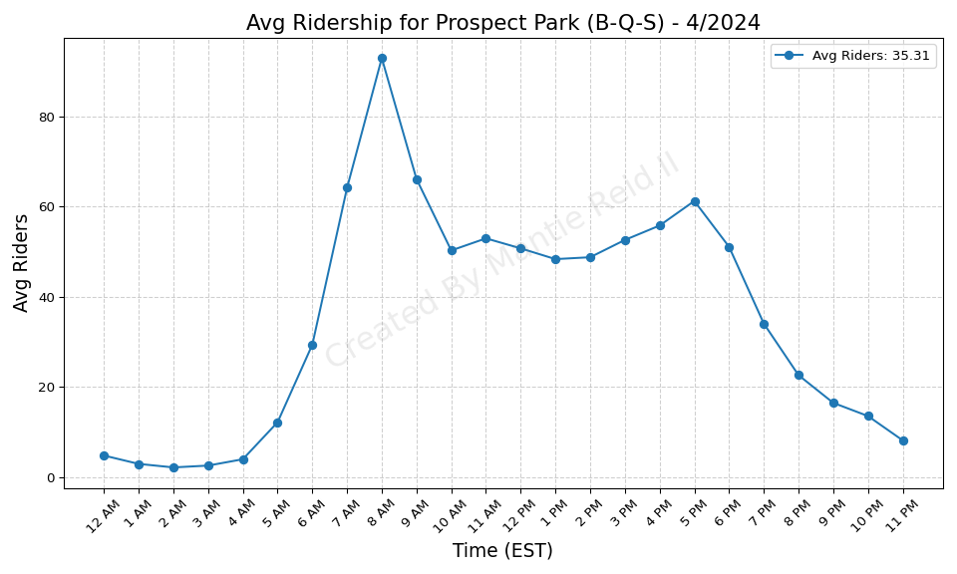
Prospect Park (B-Q-S) - 4/2024

Slide 31
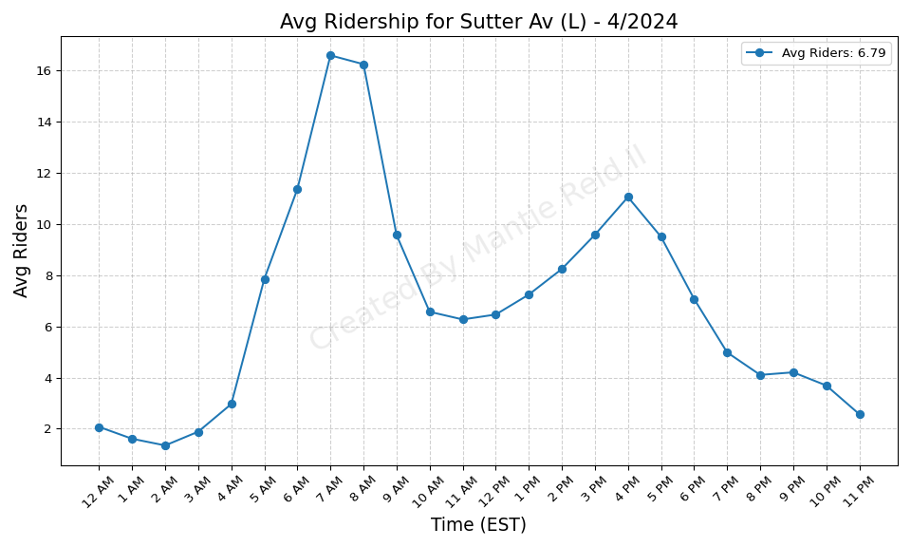
Sutter Av (L) - 4/2024

Slide 32
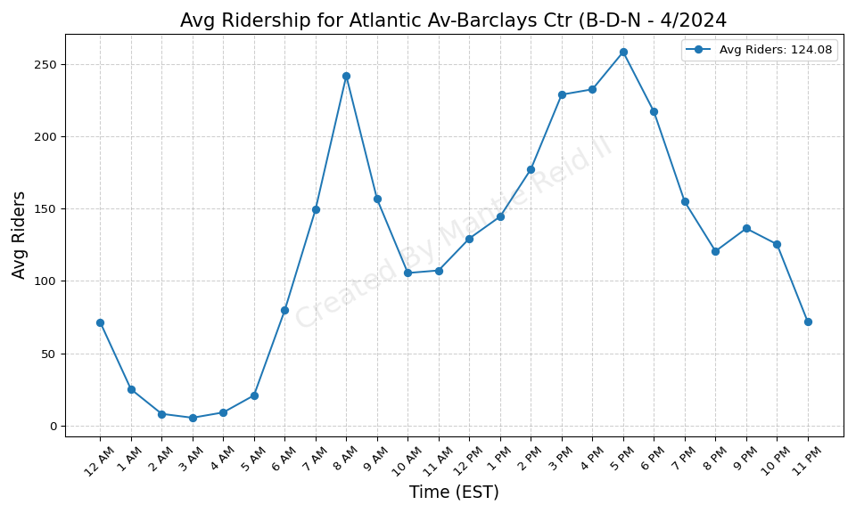
Atlantic Av-Barclays Ctr (B-D-N - 4/2024

Slide 33
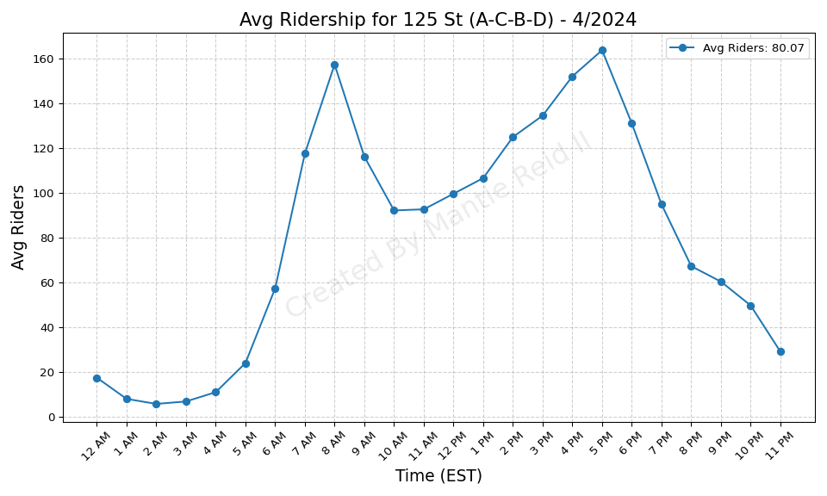
125 St (A-C-B-D) - 4/2024

Slide 34
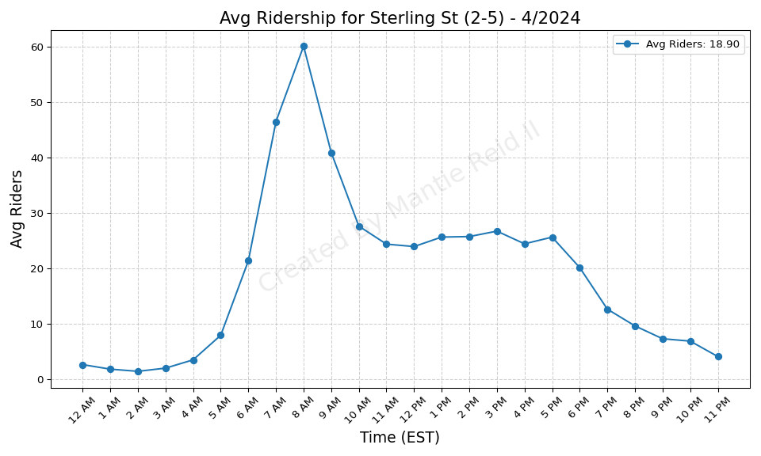
Sterling St (2-5) - 4/2024

Slide 35
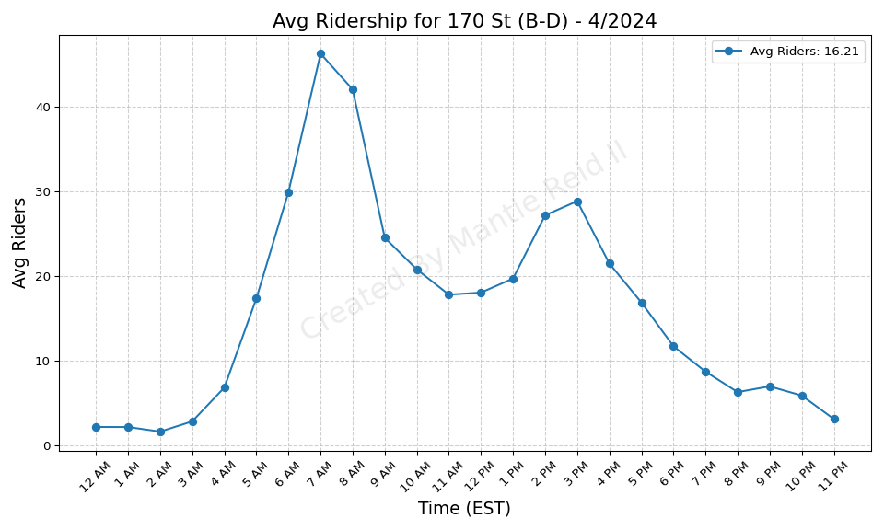
170 St (B-D) - 4/2024

Slide 36
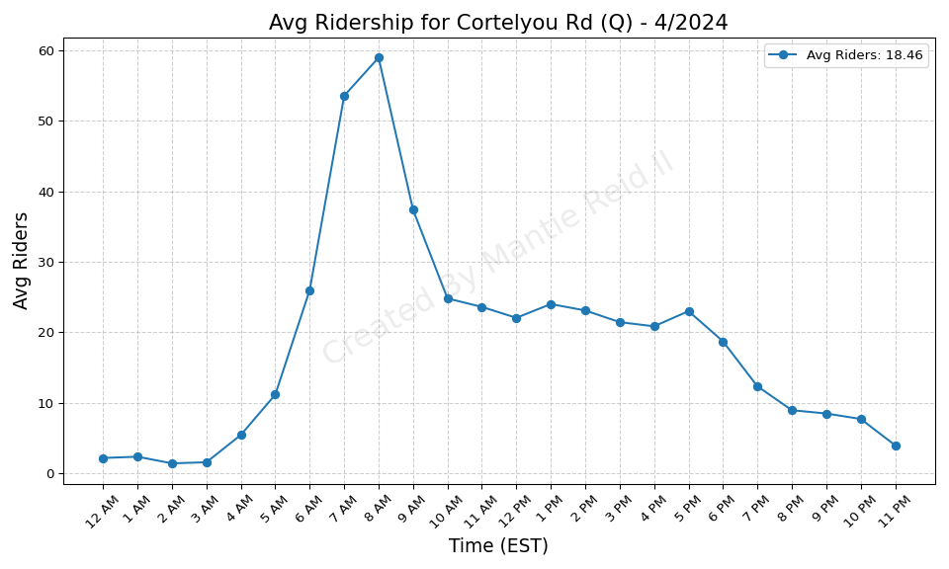
Cortelyou Rd (Q) - 4/2024

Slide 37
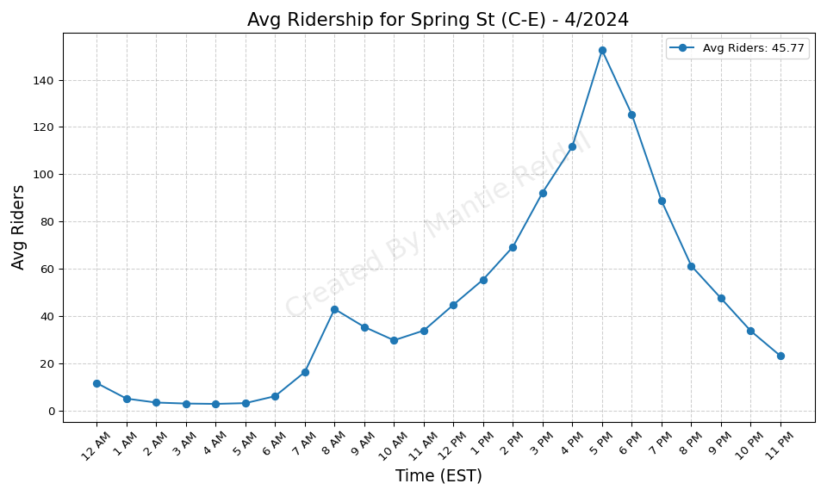
Spring St (C-E) - 4/2024

Slide 38

Burke Av (2-5) - 4/2024

Slide 39
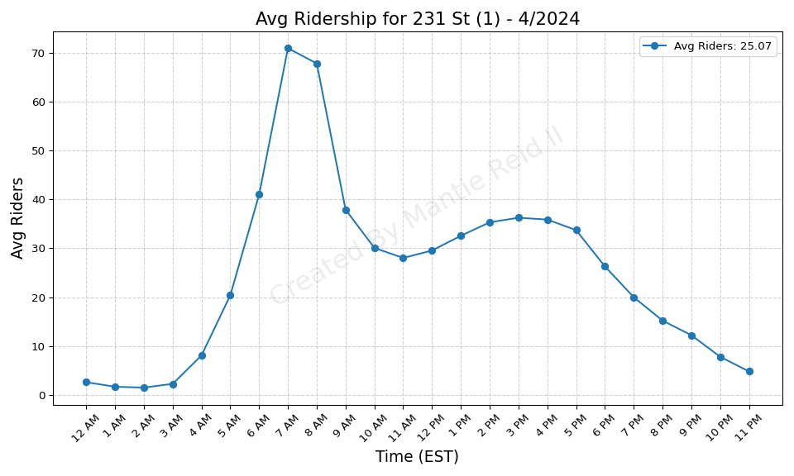
231 St (1) - 4/2024

Slide 40
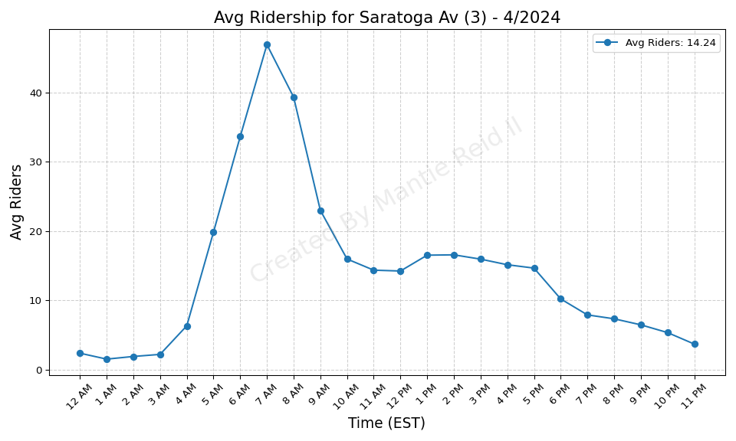
Saratoga Av (3) - 4/2024

Slide 41
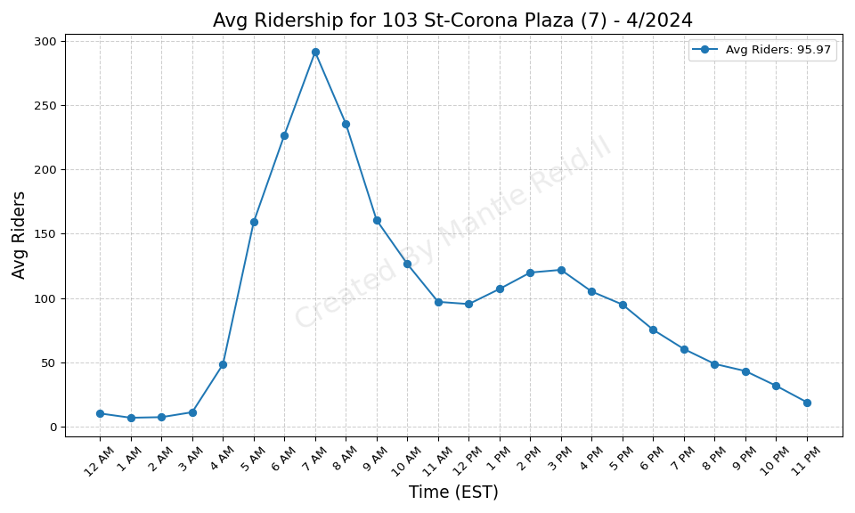
103 St-Corona Plaza (7) - 4/2024

Slide 42
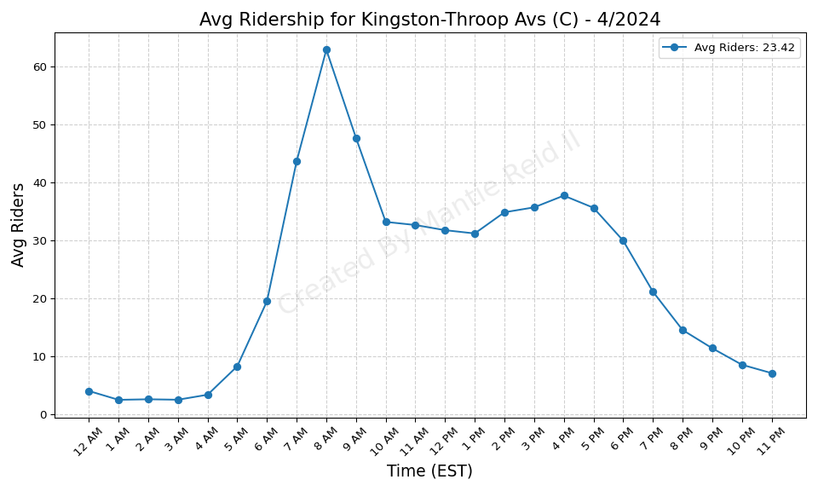
Kingston-Throop Avs (C) - 4/2024

Slide 43
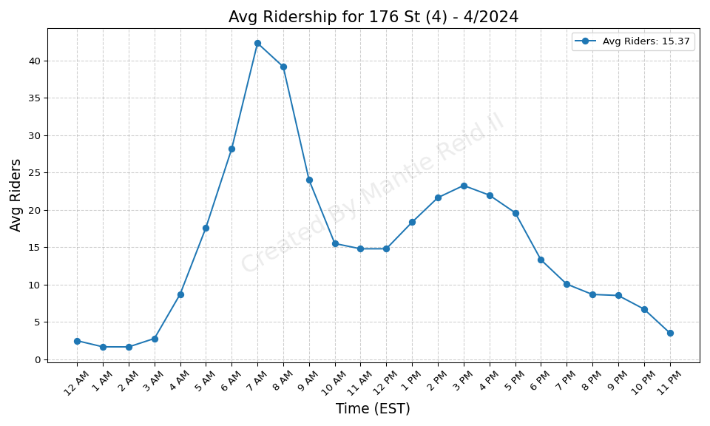
176 St (4) - 4/2024

Slide 44
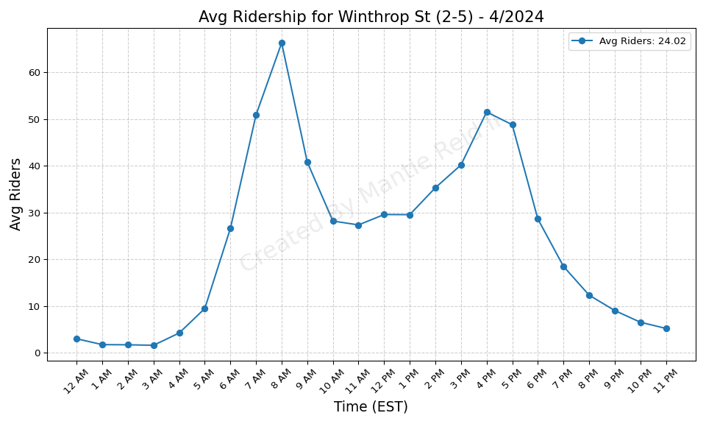
Winthrop St (2-5) - 4/2024

Slide 45

Allerton Av (2-5) - 4/2024

Slide 46
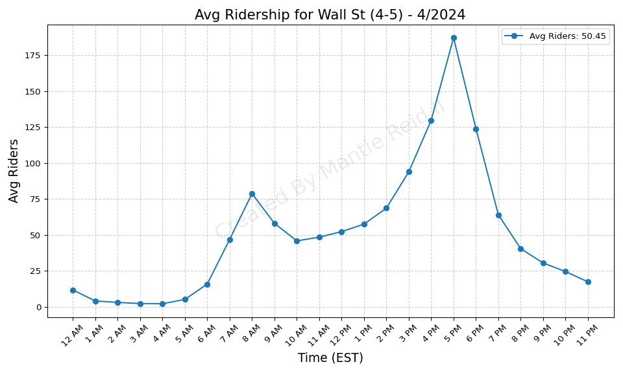
Wall St (4-5) - 4/2024

Slide 47
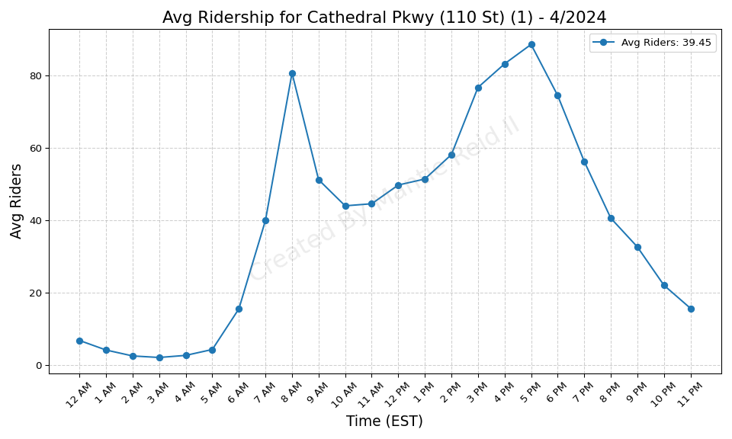
Cathedral Pkwy (110 St) (1) - 4/2024

Slide 48
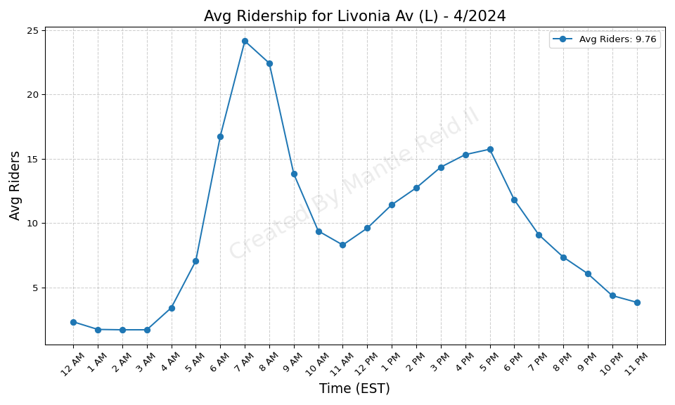
Livonia Av (L) - 4/2024

Slide 49
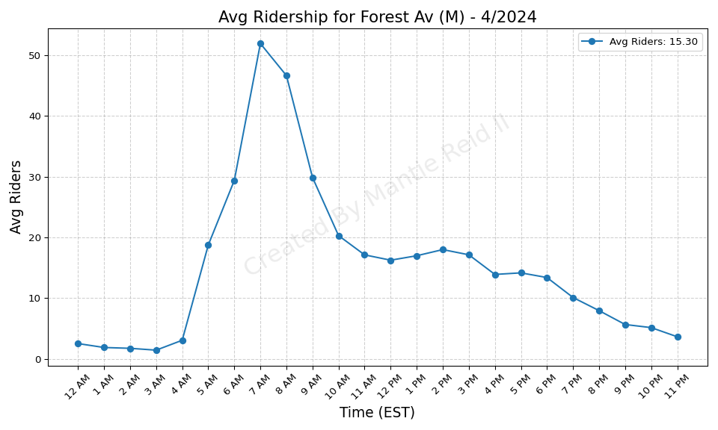
Forest Av (M) - 4/2024

Slide 50
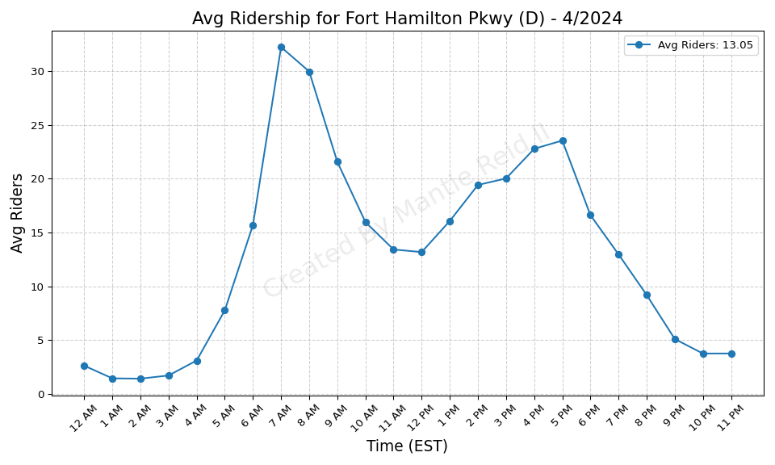
Fort Hamilton Pkwy (D) - 4/2024

Slide 51
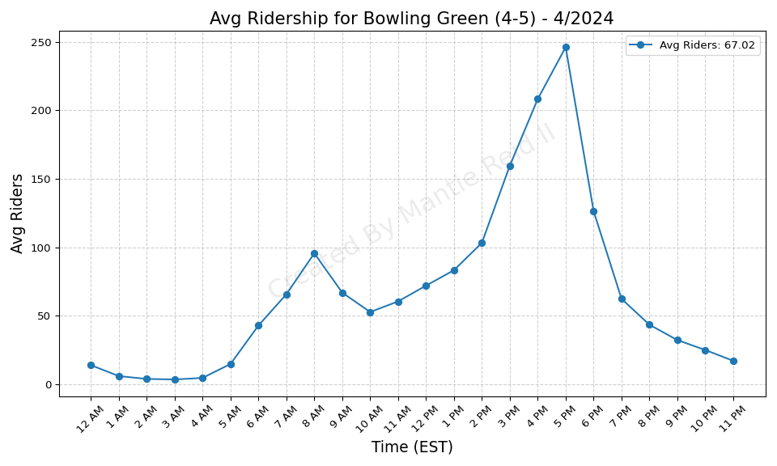
Bowling Green (4-5) - 4/2024

Slide 52
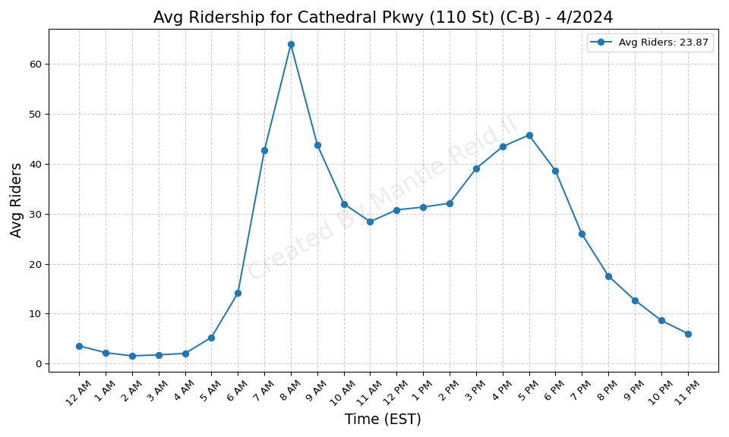
Cathedral Pkwy (110 St) (C-B) - 4/2024

Slide 53
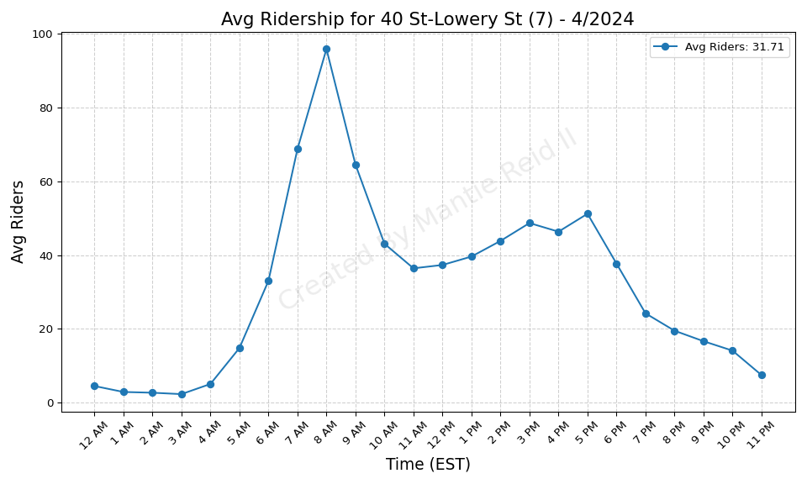
40 St-Lowery St (7) - 4/2024

Slide 54
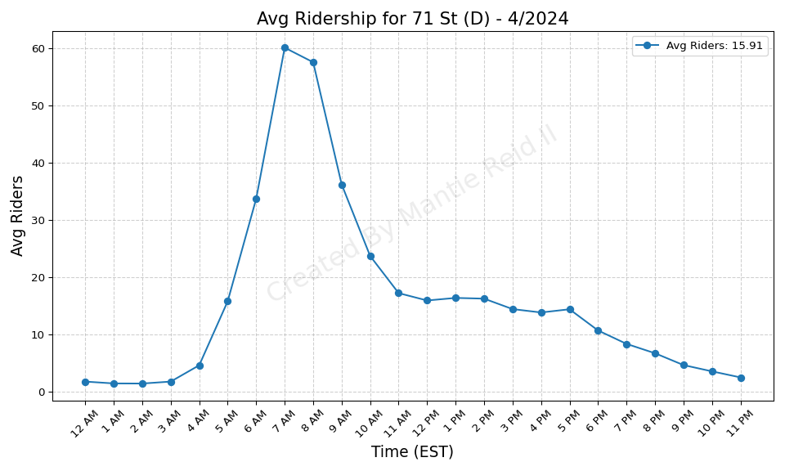
71 St (D) - 4/2024

Slide 55

Rockaway Park-Beach 116 St (A-S - 4/2024

Slide 56

Longwood Av (6) - 4/2024

Slide 57

Bay Pkwy (F) - 4/2024

Slide 58

West Farms Sq-E Tremont Av (2-5 - 4/2024

Slide 59

135 St (C-B) - 4/2024

Slide 60

Brighton Beach (B-Q) - 4/2024

Slide 61

57 St (F) - 4/2024

Slide 62

3 Av (L) - 4/2024

Slide 63

181 St (1) - 4/2024

Slide 64

7 Av (F-G) - 4/2024

Slide 65

219 St (2-5) - 4/2024

Slide 66

WTC Cortlandt (1) - 4/2024

Slide 67

DeKalb Av (B-Q-R) - 4/2024

Slide 68

Intervale Av (2-5) - 4/2024

Slide 69

Delancey St (F)-Essex St (J-M-Z - 4/2024

Slide 70

82 St-Jackson Hts (7) - 4/2024

Slide 71

Bay Pkwy (D) - 4/2024

Slide 72

Prospect Av (R) - 4/2024

Slide 73

Inwood-207 St (A) - 4/2024

Slide 74

5 Av-59 St (N-R-W) - 4/2024

Slide 75

Tremont Av (B-D) - 4/2024

Slide 76

Hoyt-Schermerhorn Sts (A-C-G) - 4/2024

Slide 77

Ditmas Av (F) - 4/2024

Slide 78

86 St (R) - 4/2024

Slide 79

5 Av-53 St (E-M) - 4/2024

Slide 80

50 St (C-E) - 4/2024

Slide 81

Lexington Av (N-R-W)-59 St (4-5 - 4/2024

Slide 82

Newkirk Plaza (B-Q) - 4/2024

Slide 83

25 St (R) - 4/2024

Slide 84

Van Cortlandt Park-242 St (1) - 4/2024

Slide 85

Cypress Av (6) - 4/2024

Slide 86

86 St (C-B) - 4/2024

Slide 87

Lafayette Av (C) - 4/2024

Slide 88

169 St (F) - 4/2024

Slide 89

52 St (7) - 4/2024

Slide 90

Parkchester (6) - 4/2024

Slide 91

Grant Av (A) - 4/2024

Slide 92

Prince St (R-W) - 4/2024

Slide 93

Avenue J (Q) - 4/2024

Slide 94

Woodlawn (4) - 4/2024

Slide 95

Broad Channel (A-S) - 4/2024

Slide 96

Central Park North (110 St) (2- - 4/2024

Slide 97

18 Av (F) - 4/2024

Slide 98

Tompkinsville (SIR) - 4/2024

Slide 99

Fresh Pond Rd (M) - 4/2024

Slide 100

Beach 67 St (A) - 4/2024

Slide 101

Avenue U (F) - 4/2024

Slide 102

103 St (1) - 4/2024

Slide 103

RI Tramway (Roosevelt) - 4/2024

Slide 104

Flatbush Av-Brooklyn College (2 - 4/2024

Slide 105

104 St (A) - 4/2024

Slide 106

Brooklyn Bridge-City Hall (4-5- - 4/2024

Slide 107

Rockaway Av (C) - 4/2024

Slide 108

Rector St (1) - 4/2024

Slide 109

Carroll St (F-G) - 4/2024

Slide 110

Kingsbridge Rd (4) - 4/2024

Slide 111

St George (SIR) - 4/2024

Slide 112

Fulton St (A-C-J-Z-2-3-4-5) - 4/2024

Slide 113

86 St (Q) - 4/2024

Slide 114

Astor Pl (6) - 4/2024

Slide 115

46 St (M-R) - 4/2024

Slide 116

111 St (7) - 4/2024

Slide 117

New Lots Av (3) - 4/2024

Slide 118

Ocean Pkwy (Q) - 4/2024

Slide 119

Cleveland St (J) - 4/2024

Slide 120

Bronx Park East (2-5) - 4/2024

Slide 121

Astoria Blvd (N-W) - 4/2024

Slide 122

145 St (1) - 4/2024

Slide 123

Pennsylvania Av (3) - 4/2024

Slide 124

Avenue I (F) - 4/2024

Slide 125

28 St (1) - 4/2024

Slide 126

Lorimer St (M-J) - 4/2024

Slide 127

23 St (F-M) - 4/2024

Slide 128

138 St-Grand Concourse (4-5) - 4/2024

Slide 129

59 St-Columbus Circle (A-B-C-D- - 4/2024

Slide 130

Bedford Park Blvd (B-D) - 4/2024

Slide 131

45 St (R) - 4/2024

Slide 132

Middletown Rd (6) - 4/2024

Slide 133

Jamaica-179 St (F) - 4/2024

Slide 134

25 Av (D) - 4/2024

Slide 135

Baychester Av (5) - 4/2024

Slide 136

207 St (1) - 4/2024

Slide 137

36 Av (N-W) - 4/2024

Slide 138

Chambers St (1-2-3) - 4/2024

Slide 139

Nassau Av (G) - 4/2024

Slide 140

Rockaway Blvd (A) - 4/2024

Slide 141

116 St (2-3) - 4/2024

Slide 142

Aqueduct Racetrack (A) - 4/2024

Slide 143

Franklin St (1) - 4/2024

Slide 144

175 St (A) - 4/2024

Slide 145

Steinway St (M-R) - 4/2024

Slide 146

New Lots Av (L) - 4/2024

Slide 147

Kosciuszko St (J) - 4/2024

Slide 148

Howard Beach-JFK Airport (A) - 4/2024

Slide 149

Canal St (J-N-Q-R-W-Z-6) - 4/2024

Slide 150

Court Sq (E-G-M-7) - 4/2024

Slide 151

Montrose Av (L) - 4/2024

Slide 152

Franklin Av (C-S) - 4/2024

Slide 153

Jefferson St (L) - 4/2024

Slide 154

Fordham Rd (B-D) - 4/2024

Slide 155

Woodhaven Blvd (M-R) - 4/2024

Slide 156

Grand St (B-D) - 4/2024

Slide 157

Fordham Rd (4) - 4/2024

Slide 158

Christopher St-Sheridan Sq (1) - 4/2024

Slide 159

125 St (1) - 4/2024

Slide 160

Marcy Av (M-J-Z) - 4/2024

Slide 161

50 St (D) - 4/2024

Slide 162

Union St (R) - 4/2024

Slide 163

157 St (1) - 4/2024

Slide 164

Vernon Blvd-Jackson Av (7) - 4/2024

Slide 165

18 St (1) - 4/2024

Slide 166

Beach 44 St (A) - 4/2024

Slide 167

Kings Hwy (F) - 4/2024

Slide 168

59 St (N-R) - 4/2024

Slide 169

7 Av (E-B-D) - 4/2024

Slide 170

Kings Hwy (N) - 4/2024

Slide 171

67 Av (M-R) - 4/2024

Slide 172

7 Av (B-Q) - 4/2024

Slide 173

30 Av (N-W) - 4/2024

Slide 174

Sutphin Blvd (F) - 4/2024

Slide 175

Central Av (M) - 4/2024

Slide 176

Bergen St (2-3) - 4/2024

Slide 177

15 St-Prospect Park (F-G) - 4/2024

Slide 178

163 St-Amsterdam Av (C) - 4/2024

Slide 179

34 St-Hudson Yards (7) - 4/2024

Slide 180

14 St-Union Sq (L-N-Q-R-W-4-5-6 - 4/2024

Slide 181

23 St (6) - 4/2024

Slide 182

Mosholu Pkwy (4) - 4/2024

Slide 183

3 Av-138 St (6) - 4/2024

Slide 184

20 Av (D) - 4/2024

Slide 185

Crown Hts-Utica Av (3-4) - 4/2024

Slide 186

Coney Island-Stillwell Av (D-F- - 4/2024

Slide 187

York St (F) - 4/2024

Slide 188

23 St (R-W) - 4/2024

Slide 189

96 St (1-2-3) - 4/2024

Slide 190

Lorimer St (L)-Metropolitan Av - 4/2024

Slide 191

Van Siclen Av (J-Z) - 4/2024

Slide 192

14 St (F-M-1-2-3)-6 Av (L) - 4/2024

Slide 193

Lexington Av-63 St (F-Q) - 4/2024

Slide 194

Woodhaven Blvd (J-Z) - 4/2024

Slide 195

14 St (A-C-E)-8 Av (L) - 4/2024

Slide 196

Middle Village-Metropolitan Av - 4/2024

Slide 197

50 St (1) - 4/2024

Slide 198

Sheepshead Bay (B-Q) - 4/2024

Slide 199

Church Av (2-5) - 4/2024

Slide 200

Gun Hill Rd (5) - 4/2024

Slide 201

21 St-Queensbridge (F) - 4/2024

Slide 202

145 St (A-C-B-D) - 4/2024

Slide 203

4 Av (F-G)-9 St (R) - 4/2024

Slide 204

191 St (1) - 4/2024

Slide 205

Norwood-205 St (D) - 4/2024

Slide 206

Bay 50 St (D) - 4/2024

Slide 207

Pelham Pkwy (2-5) - 4/2024

Slide 208

Court St (R)-Borough Hall (2-3- - 4/2024

Slide 209

Jackson Av (2-5) - 4/2024

Slide 210

Bryant Pk (B-D-F-M)-5 Av (7) - 4/2024

Slide 211

116 St (6) - 4/2024

Slide 212

Eastern Pkwy-Brooklyn Museum (2 - 4/2024

Slide 213

Buhre Av (6) - 4/2024

Slide 214

215 St (1) - 4/2024

Slide 215

Church Av (F-G) - 4/2024

Slide 216

E 180 St (2-5) - 4/2024

Slide 217

47-50 Sts-Rockefeller Ctr (B-D- - 4/2024

Slide 218

86 St (1) - 4/2024

Slide 219

Dyckman St (A) - 4/2024

Slide 220

125 St (2-3) - 4/2024

Slide 221

Chauncey St (J-Z) - 4/2024

Slide 222

Westchester Sq-E Tremont Av (6) - 4/2024

Slide 223

Jay St-MetroTech (A-C-F-R) - 4/2024

Slide 224

East Broadway (F) - 4/2024

Slide 225

Beach 60 St (A) - 4/2024

Slide 226

Junius St (3) - 4/2024

Slide 227

Freeman St (2-5) - 4/2024

Slide 228

Mt Eden Av (4) - 4/2024

Slide 229

Beach 36 St (A) - 4/2024

Slide 230

Chambers St (A-C)-WTC (E)-Park - 4/2024

Slide 231

E 149 St (6) - 4/2024

Slide 232

90 St-Elmhurst Av (7) - 4/2024

Slide 233

Castle Hill Av (6) - 4/2024

Slide 234

Nostrand Av (3) - 4/2024

Slide 235

Prospect Av (2-5) - 4/2024

Slide 236

96 St (6) - 4/2024

Slide 237

Wakefield-241 St (2) - 4/2024

Slide 238

Marble Hill-225 St (1) - 4/2024

Slide 239

Flushing Av (M-J) - 4/2024

Slide 240

79 St (1) - 4/2024

Slide 241

Atlantic Av (L) - 4/2024

Slide 242

Bedford Park Blvd-Lehman Colleg - 4/2024

Slide 243

103 St (C-B) - 4/2024

Slide 244

Bay Pkwy (N) - 4/2024

Slide 245

68 St-Hunter College (6) - 4/2024

Slide 246

Flushing Av (G) - 4/2024

Slide 247

Bay Ridge Av (R) - 4/2024

Slide 248

Myrtle Av (M-J-Z) - 4/2024

Slide 249

Grand Central-42 St (S-4-5-6-7) - 4/2024

Slide 250

Broadway-Lafayette St (B-D-F-M) - 4/2024

Slide 251

121 St (J-Z) - 4/2024

Slide 252

Sutter Av-Rutland Rd (3) - 4/2024

Slide 253

Burnside Av (4) - 4/2024

Slide 254

39 Av-Dutch Kills (N-W) - 4/2024

Slide 255

190 St (A) - 4/2024

Slide 256

Times Sq-42 St (N-Q-R-W-S-1-2-3 - 4/2024

Slide 257

Knickerbocker Av (M) - 4/2024

Slide 258

23 St (1) - 4/2024

Slide 259

18 Av (N) - 4/2024

Slide 260

Eastchester-Dyre Av (5) - 4/2024

Slide 261

8 Av (N) - 4/2024

Slide 262

8 St-NYU (R-W) - 4/2024

Slide 263

23 St (C-E) - 4/2024

Slide 264

55 St (D) - 4/2024

Slide 265

Ozone Park-Lefferts Blvd (A) - 4/2024

Slide 266

33 St (6) - 4/2024

Slide 267

Van Siclen Av (3) - 4/2024

Slide 268

Bergen St (F-G) - 4/2024

Slide 269

75 St-Elderts Ln (J-Z) - 4/2024

Slide 270

Crescent St (J-Z) - 4/2024

Slide 271

111 St (A) - 4/2024

Slide 272

9 Av (D) - 4/2024

Slide 273

66 St-Lincoln Center (1) - 4/2024

Slide 274

Astoria-Ditmars Blvd (N-W) - 4/2024

Slide 275

Pelham Pkwy (5) - 4/2024

Slide 276

28 St (R-W) - 4/2024

Slide 277

74-Broadway (7)-Jackson Hts-Roo - 4/2024

Slide 278

80 St (A) - 4/2024

Slide 279

Smith-9 Sts (F-G) - 4/2024

Slide 280

18 Av (D) - 4/2024

Slide 281

Canal St (A-C-E) - 4/2024

Slide 282

Utica Av (A-C) - 4/2024

Slide 283

167 St (B-D) - 4/2024

Slide 284

RI Tramway (Manhattan) - 4/2024

Slide 285

Morris Park (5) - 4/2024

Slide 286

Hunters Point Av (7) - 4/2024

Slide 287

Myrtle-Wyckoff Avs (L-M) - 4/2024

Slide 288

Halsey St (J) - 4/2024

Slide 289

181 St (A) - 4/2024

Slide 290

72 St (Q) - 4/2024

Slide 291

88 St (A) - 4/2024

Slide 292

Beverley Rd (Q) - 4/2024

Slide 293

96 St (C-B) - 4/2024

Slide 294

Far Rockaway-Mott Av (A) - 4/2024

Slide 295

238 St (1) - 4/2024

Slide 296

City Hall (R-W) - 4/2024

Slide 297

Briarwood (E-F) - 4/2024

Slide 298

Houston St (1) - 4/2024

Slide 299

W 4 St-Wash Sq (A-C-E-B-D-F-M) - 4/2024

Slide 300

Myrtle-Willoughby Avs (G) - 4/2024

Slide 301

Broad St (J-Z) - 4/2024

Slide 302

46 St-Bliss St (7) - 4/2024

Slide 303

Canarsie-Rockaway Pkwy (L) - 4/2024

Slide 304

Beach 90 St (A-S) - 4/2024

Slide 305

Spring St (6) - 4/2024

Slide 306

28 St (6) - 4/2024

Slide 307

Junction Blvd (7) - 4/2024

Slide 308

Flushing-Main St (7) - 4/2024

Slide 309

111 St (J) - 4/2024

Slide 310

34 St-Penn Station (A-C-E) - 4/2024

Slide 311

61 St-Woodside (7) - 4/2024

Slide 312

Jamaica Center-Parsons-Archer ( - 4/2024

Slide 313

Broadway (N-W) - 4/2024

Slide 314

72 St (C-B) - 4/2024

Slide 315

Liberty Av (C) - 4/2024

Slide 316

103 St (6) - 4/2024

Slide 317

85 St-Forest Pkwy (J) - 4/2024

Slide 318

Kew Gardens-Union Tpke (E-F) - 4/2024

Slide 319

135 St (2-3) - 4/2024

Slide 320

Hoyt St (2-3) - 4/2024

Slide 321

Beach 105 St (A-S) - 4/2024

Slide 322

Rockaway Av (3) - 4/2024

Slide 323

Bay Ridge-95 St (R) - 4/2024

Slide 324

69 St (7) - 4/2024

Slide 325

Jamaica-Van Wyck (E) - 4/2024

Slide 326

Forest Hills-71 Av (E-F-M-R) - 4/2024

Slide 327

145 St (3) - 4/2024

Slide 328

Northern Blvd (M-R) - 4/2024

Slide 329

34 St-Herald Sq (B-D-F-M-N-Q-R- - 4/2024

Slide 330

Simpson St (2-5) - 4/2024

Slide 331

Brook Av (6) - 4/2024

Slide 332

Bushwick Av-Aberdeen St (L) - 4/2024

Slide 333

Canal St (1) - 4/2024

Slide 334

53 St (R) - 4/2024

Slide 335

Sutphin Blvd-Archer Av-JFK Airp - 4/2024

Slide 336

20 Av (N) - 4/2024

Slide 337

Pelham Bay Park (6) - 4/2024

Slide 338

Alabama Av (J) - 4/2024

Slide 339

Mets-Willets Point (7) - 4/2024

Slide 340

33 St-Rawson St (7) - 4/2024

Slide 341

77 St (R) - 4/2024

Slide 342

South Ferry (1)-Whitehall St (R - 4/2024

Slide 343

110 St (6) - 4/2024

Slide 344

Queens Plaza (E-M-R) - 4/2024

Slide 345

Church Av (B-Q) - 4/2024

Slide 346

174-175 Sts (B-D) - 4/2024

Slide 347

49 St (N-R-W) - 4/2024

Slide 348

Harlem-148 St (3) - 4/2024

Slide 349

High St (A-C) - 4/2024

Slide 350

86 St (4-5-6) - 4/2024

Slide 351

77 St (6) - 4/2024

Slide 352

Wilson Av (L) - 4/2024

Slide 353

Elder Av (6) - 4/2024

Slide 354

183 St (4) - 4/2024

Slide 355

57 St-7 Av (N-Q-R-W) - 4/2024

Slide 356

Beach 25 St (A) - 4/2024

Slide 357

137 St-City College (1) - 4/2024

Slide 358

Fort Hamilton Pkwy (F-G) - 4/2024

Slide 359

72 St (1-2-3) - 4/2024

Slide 360

Broadway Junction (A-C-J-L-Z) - 4/2024

Slide 361

65 St (M-R) - 4/2024

Slide 362

Greenpoint Av (G) - 4/2024

Slide 363

Parkside Av (Q) - 4/2024

Slide 364

Gates Av (J-Z) - 4/2024

Slide 365

Fulton St (G) - 4/2024

Slide 366

Neptune Av (F) - 4/2024

Slide 367

79 St (D) - 4/2024

Slide 368

President St-Medgar Evers Colle - 4/2024

Slide 369

Kingsbridge Rd (B-D) - 4/2024

Slide 370

Avenue H (Q) - 4/2024

Slide 371

Dyckman St (1) - 4/2024

Slide 372

Hewes St (M-J) - 4/2024

Slide 373

Graham Av (L) - 4/2024

Slide 374

Shepherd Av (C) - 4/2024

Slide 375

Clark St (2-3) - 4/2024

Slide 376

Kings Hwy (B-Q) - 4/2024

Slide 377

Bedford Av (L) - 4/2024

Slide 378

Beverly Rd (2-5) - 4/2024

Slide 379

Newkirk Av-Little Haiti (2-5) - 4/2024

Slide 380

Beach 98 St (A-S) - 4/2024

Slide 381

96 St (Q) - 4/2024

Slide 382

Seneca Av (M) - 4/2024

Slide 383

Grand Av-Newtown (M-R) - 4/2024

Slide 384

86 St (N) - 4/2024

Slide 385

155 St (B-D) - 4/2024

Slide 386

Avenue U (Q) - 4/2024

Slide 387

Broadway (G) - 4/2024

Slide 388

Neck Rd (Q) - 4/2024

Slide 389

149 St-Grand Concourse (2-4-5) - 4/2024

Slide 390

Halsey St (L) - 4/2024

Slide 391

Bedford-Nostrand Avs (G) - 4/2024

Slide 392

W 8 St-NY Aquarium (F-Q) - 4/2024

Slide 393

E 143 St-St Mary-s St (6) - 4/2024

Slide 394

Gun Hill Rd (2-5) - 4/2024

Slide 395

Avenue M (Q) - 4/2024

Slide 396

Whitlock Av (6) - 4/2024

Slide 397

Norwood Av (J-Z) - 4/2024

Slide 398

Avenue X (F) - 4/2024

Slide 399

DeKalb Av (L) - 4/2024

Slide 400

Franklin Av (2-3-4-5)-Botanic G - 4/2024

Slide 401

Roosevelt Island (F) - 4/2024

Slide 402

Cypress Hills (J) - 4/2024

Slide 403

East 105 St (L) - 4/2024

Slide 404

36 St (M-R) - 4/2024

Slide 405

Bowery (J-Z) - 4/2024

Slide 406

170 St (4) - 4/2024

Slide 407

174 St (2-5) - 4/2024

Slide 408

Morrison Av-Soundview (6) - 4/2024

Slide 409

Morgan Av (L) - 4/2024

Slide 410

2 Av (F) - 4/2024

Slide 411

Nevins St (2-3-4-5) - 4/2024

Slide 412

116 St (C-B) - 4/2024

Slide 413

Aqueduct-N Conduit Av (A) - 4/2024

Slide 414

Rector St (R-W) - 4/2024

Slide 415

Parsons Blvd (F) - 4/2024

Slide 416

Lexington Av-53 St (E-M)-51 St - 4/2024

Slide 417

St Lawrence Av (6) - 4/2024

Slide 418

Kingston Av (3) - 4/2024

Slide 419

Avenue P (F) - 4/2024

Slide 420

36 St (D-N-R) - 4/2024

Slide 421

21 St (G) - 4/2024

Slide 422

Park Pl (S) - 4/2024

Slide 423

233 St (2-5) - 4/2024

Slide 424

104 St (J-Z) - 4/2024

Slide 425

81 St-Museum of Natural History - 4/2024

Slide 426

Grand St (L) - 4/2024

Slide 427

Classon Av (G) - 4/2024

Slide 428

63 Dr-Rego Park (M-R) - 4/2024

